Slide 1
Kinematic and Dynamic Hand Grasping Animation
Ryan Todesco

Slide 2
Inspiration
- Noticed object in video game was nor held firmly
- Took me out of the scene
- Wanted to create hand grasping animation that mirrored real world

Slide 3
Difficulties
- Accurate and stable collision
- Proper transferring of forces
- Accurate movement of hand

Slide 4
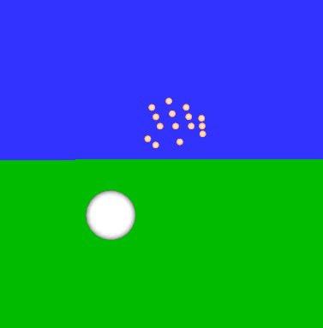
Overview
- Each item is a part of a particle system
- Forward Euler
- Dynamic major motion and Kinematic minor motion

Slide 5
Work Pipeline
Forces
Hand Look
Hand Movement
More Focus
Less Focus

Slide 6
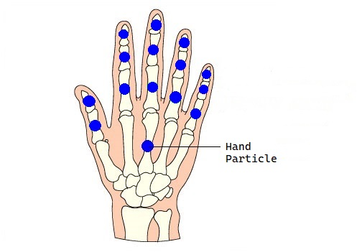
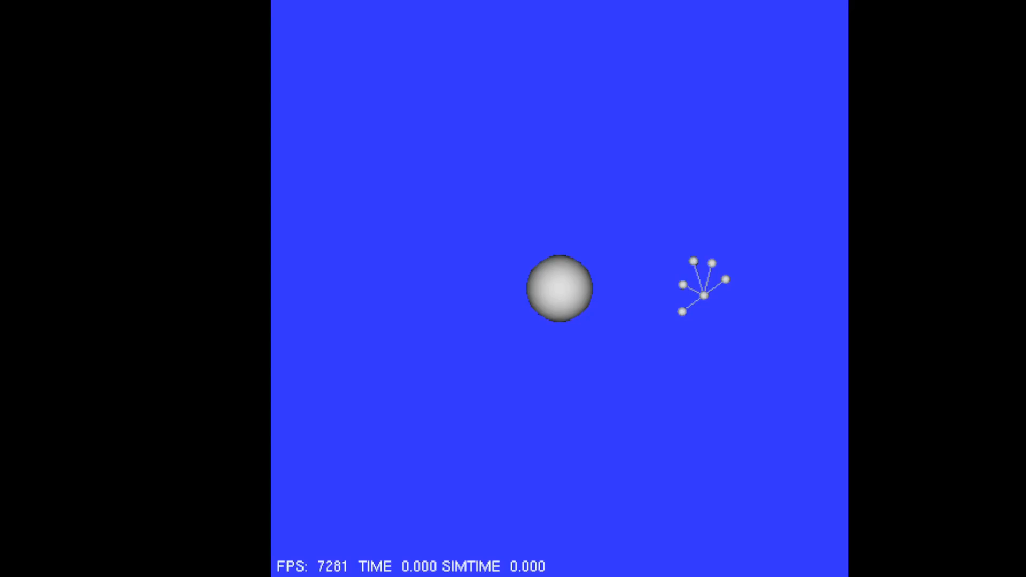
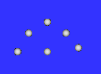
Hand Development
First Hand

Slide 7
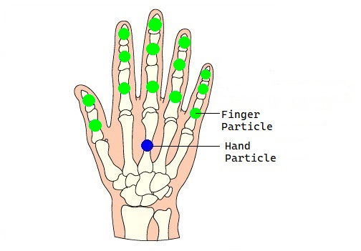
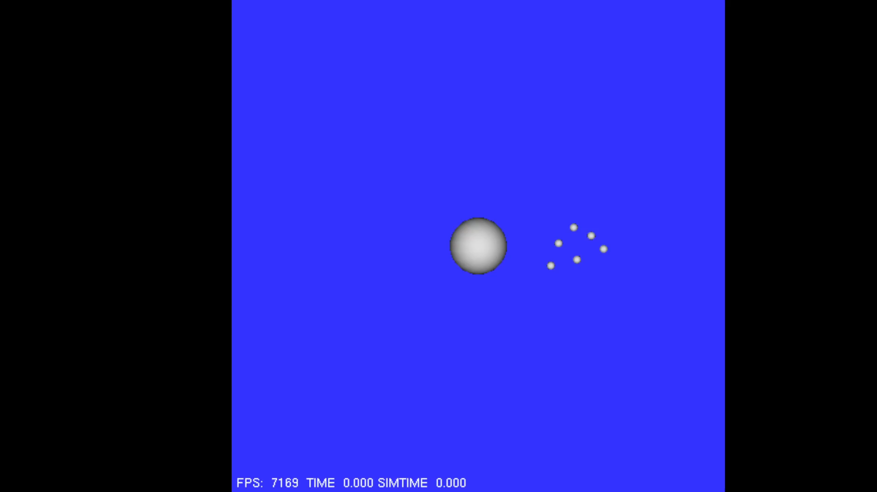
Hand Development
Second Hand

Slide 8
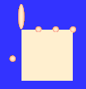
Hand Development
- Shapes were not designed to bend
-Did not meet visual evaluation

Slide 9
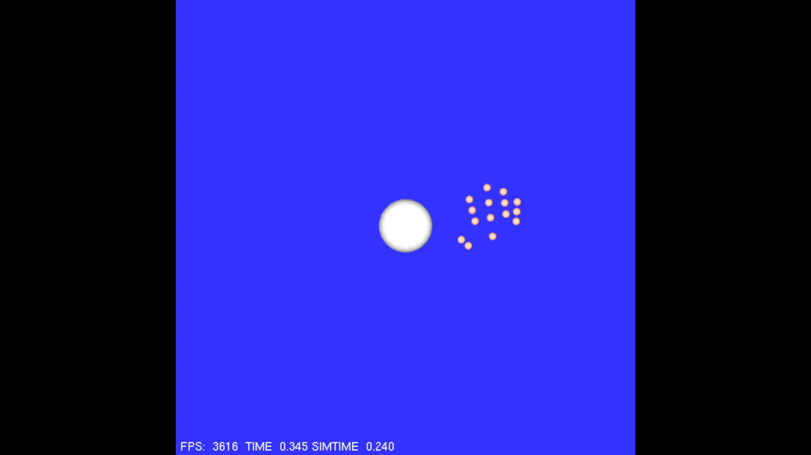
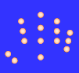
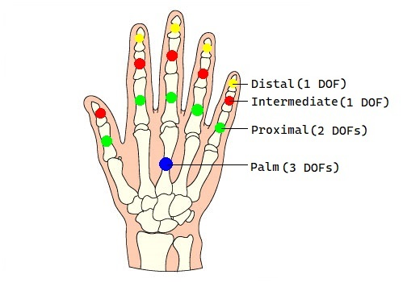
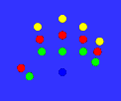
Hand Development
Final Hand

Slide 10
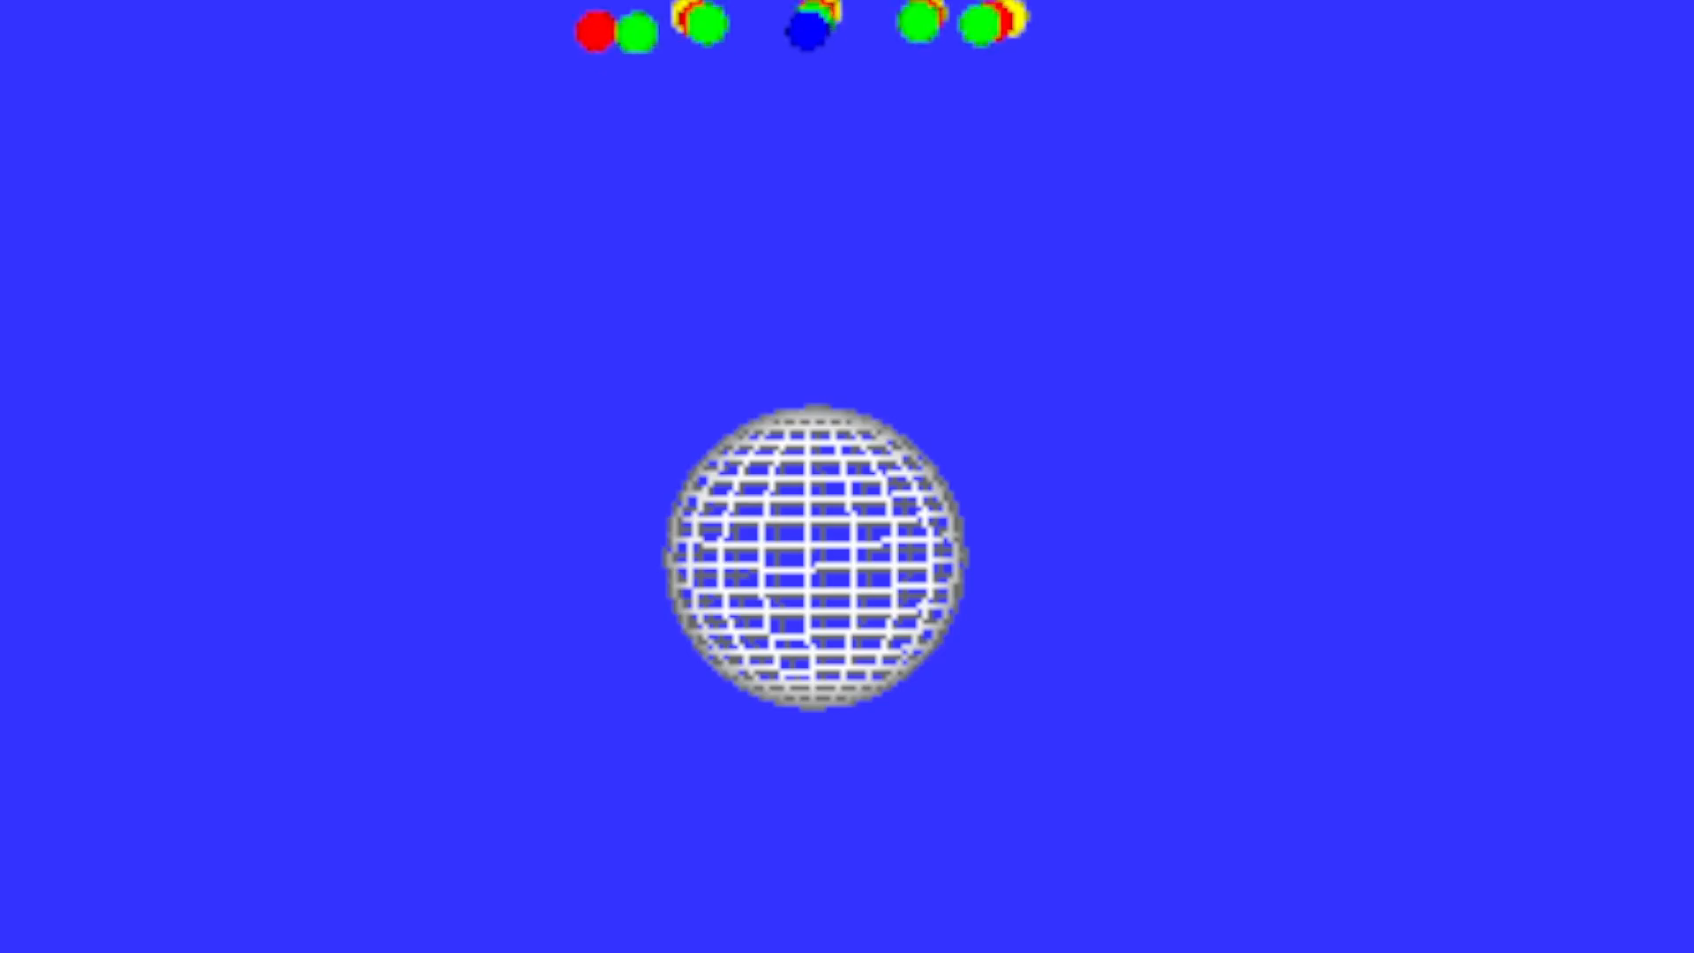
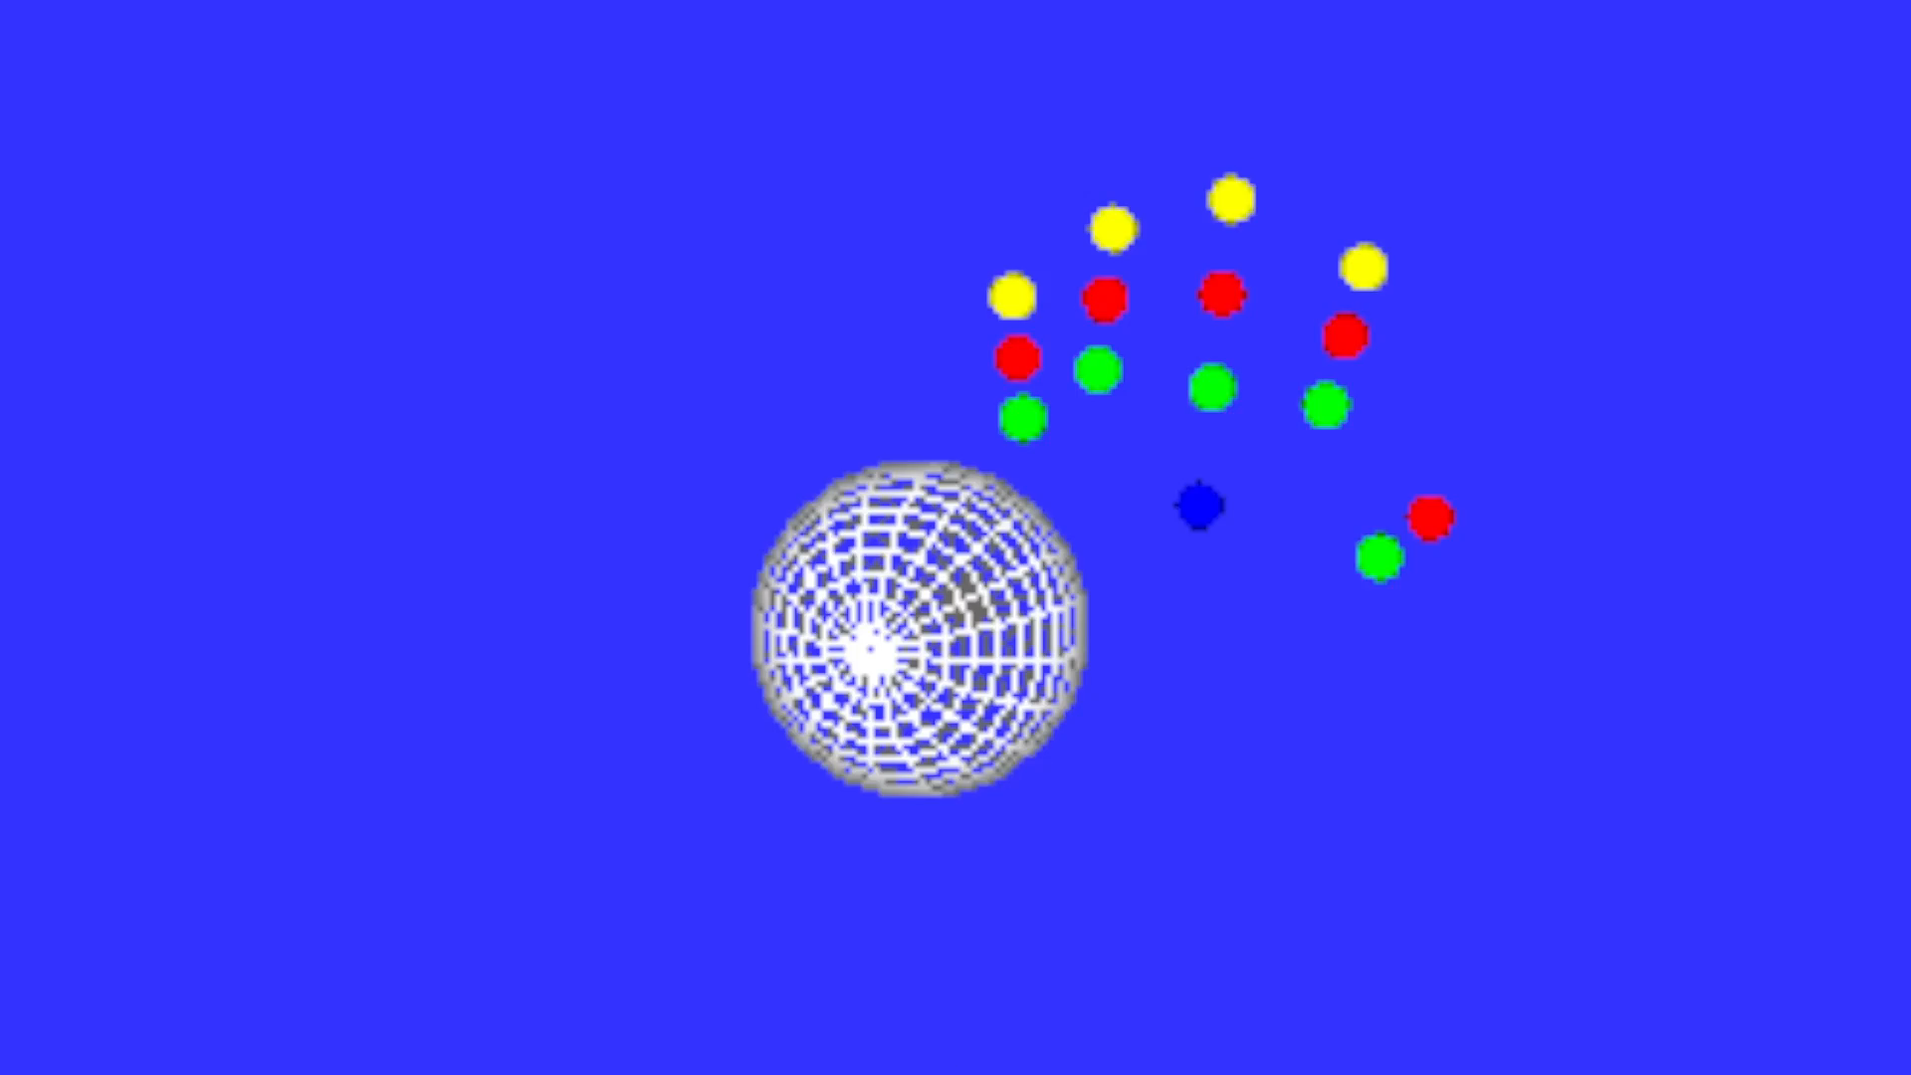
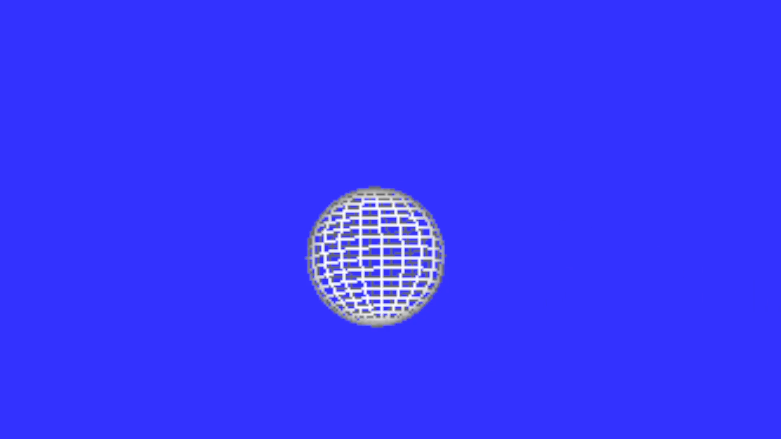
Finger Rotation

Slide 11
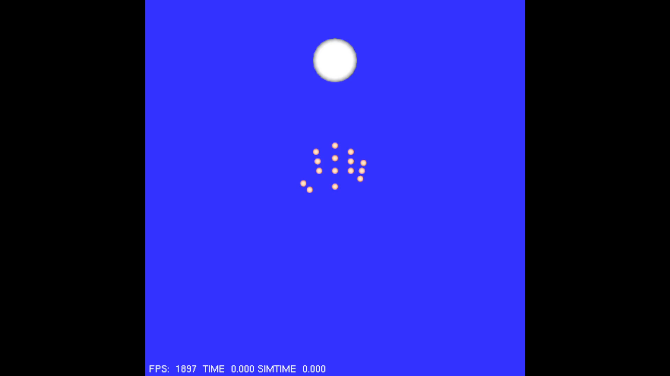
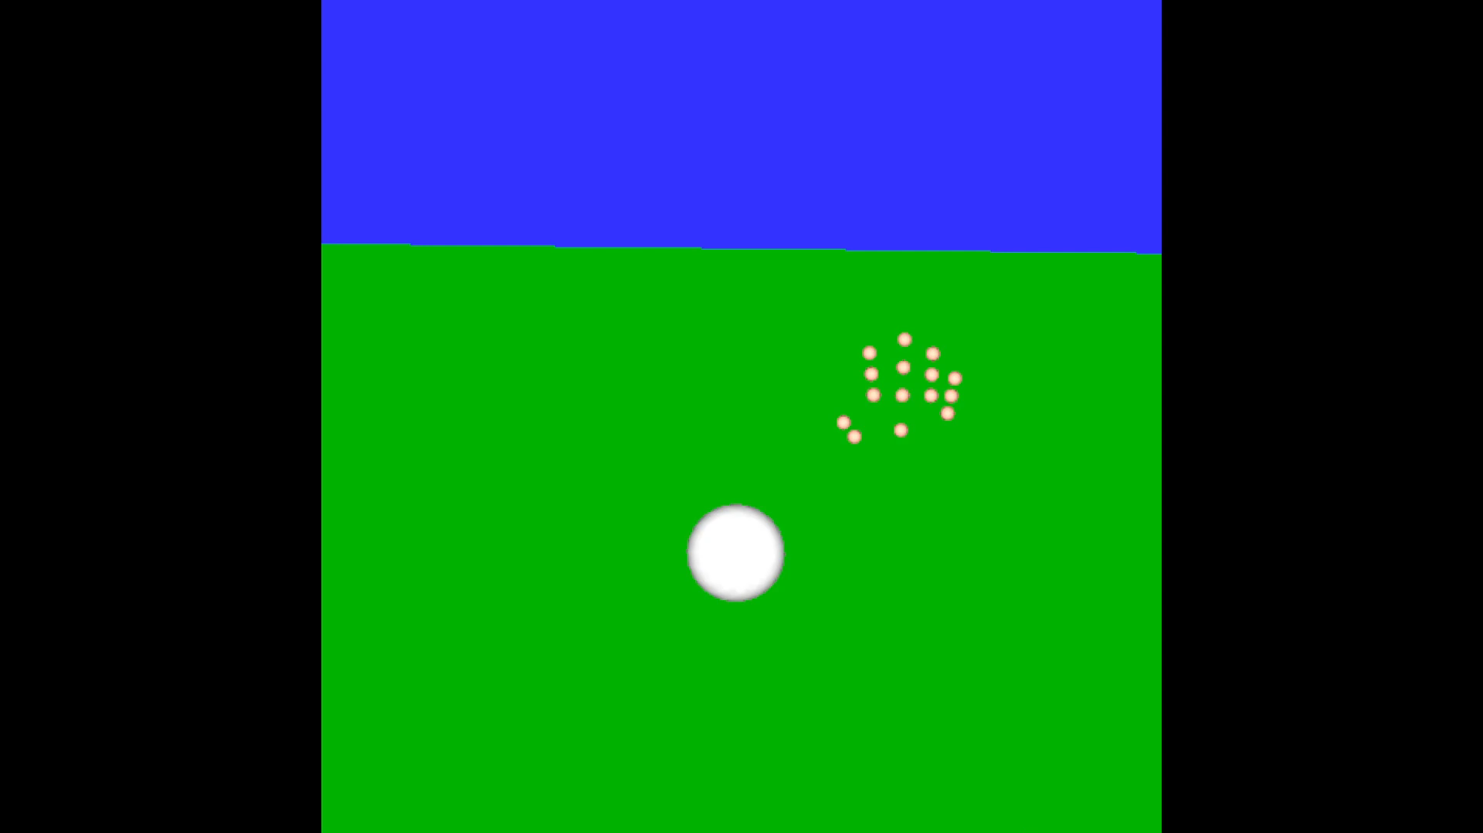
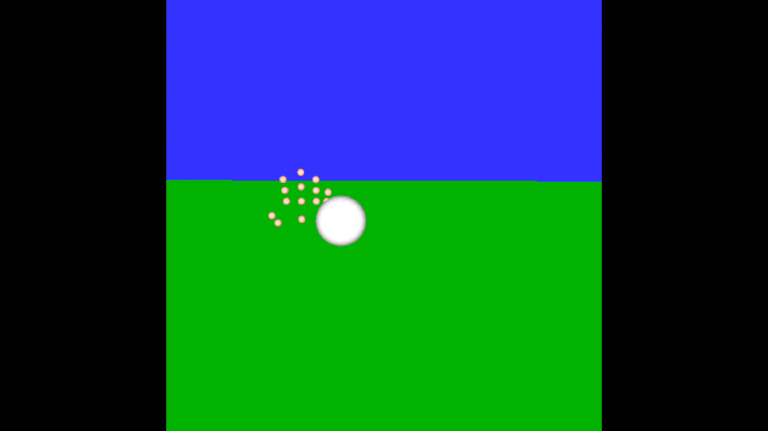
Hand Rotation

Slide 12
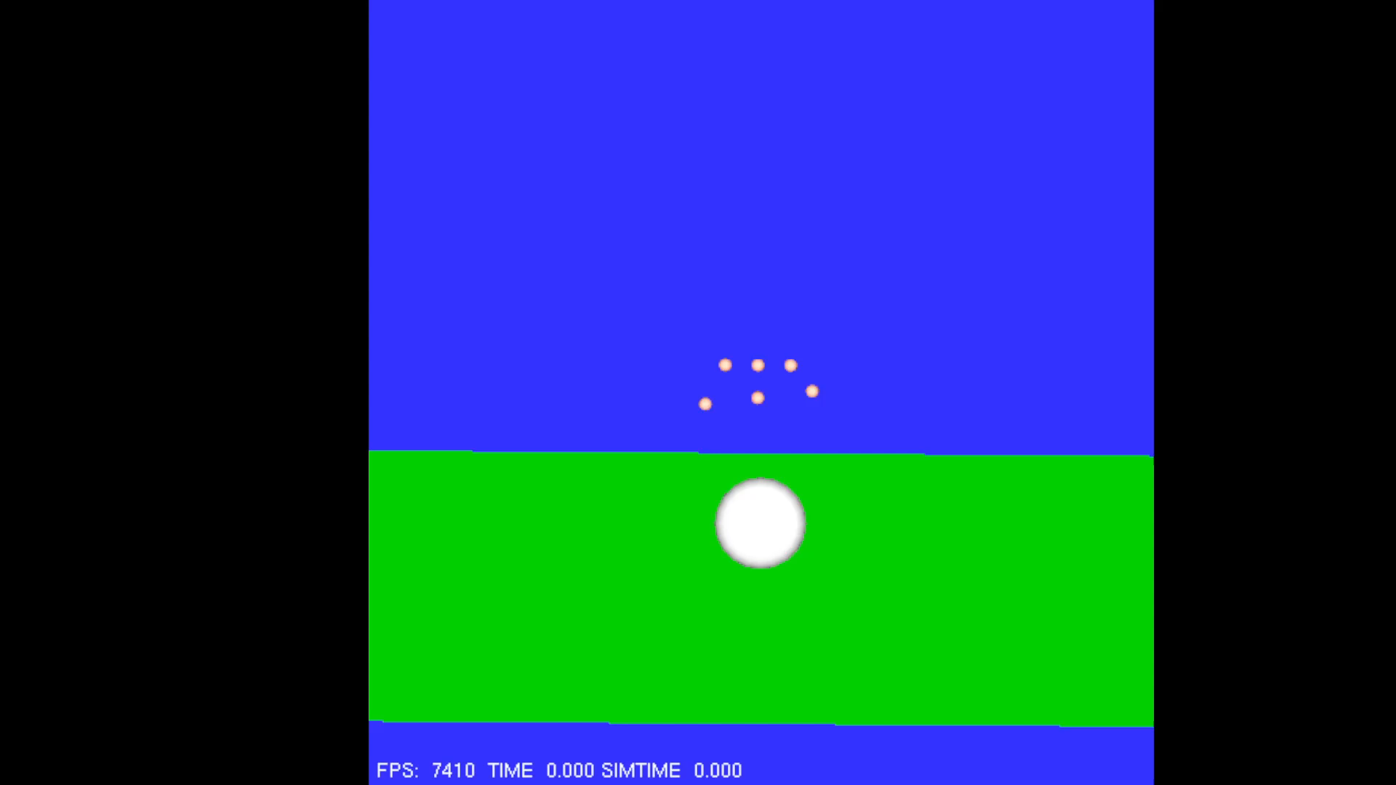
Force Transferring– Mass Problem
- Same Forces, Different Masses cause different Velocities
- Same problem caused by particle system loop

Slide 13
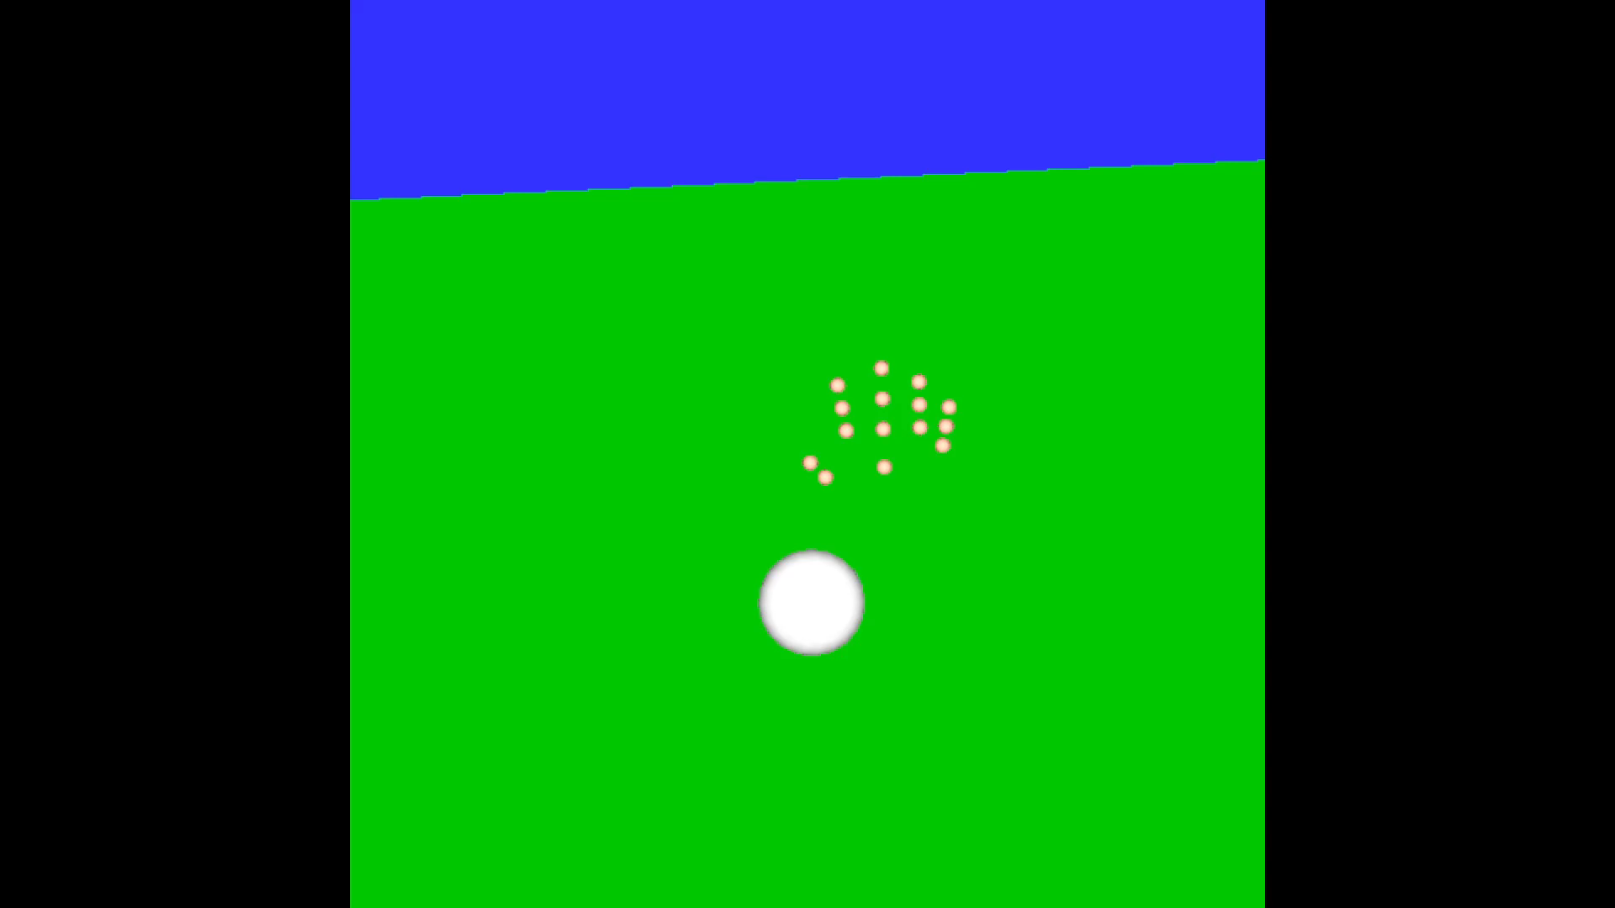
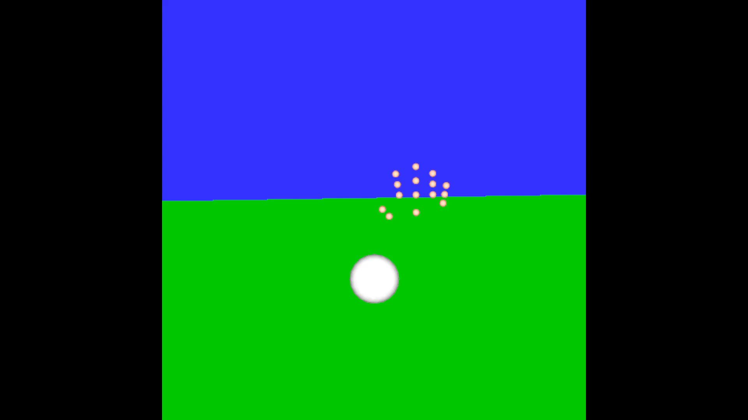
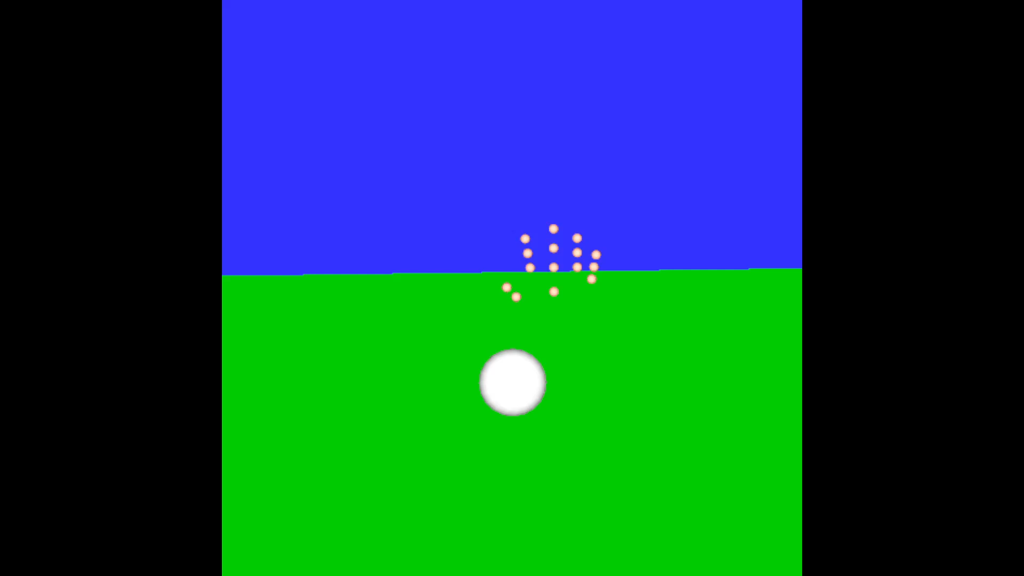
Mass = 2
Force = 19.6
Force = 20
Force = 30
Force Transferring

Slide 14
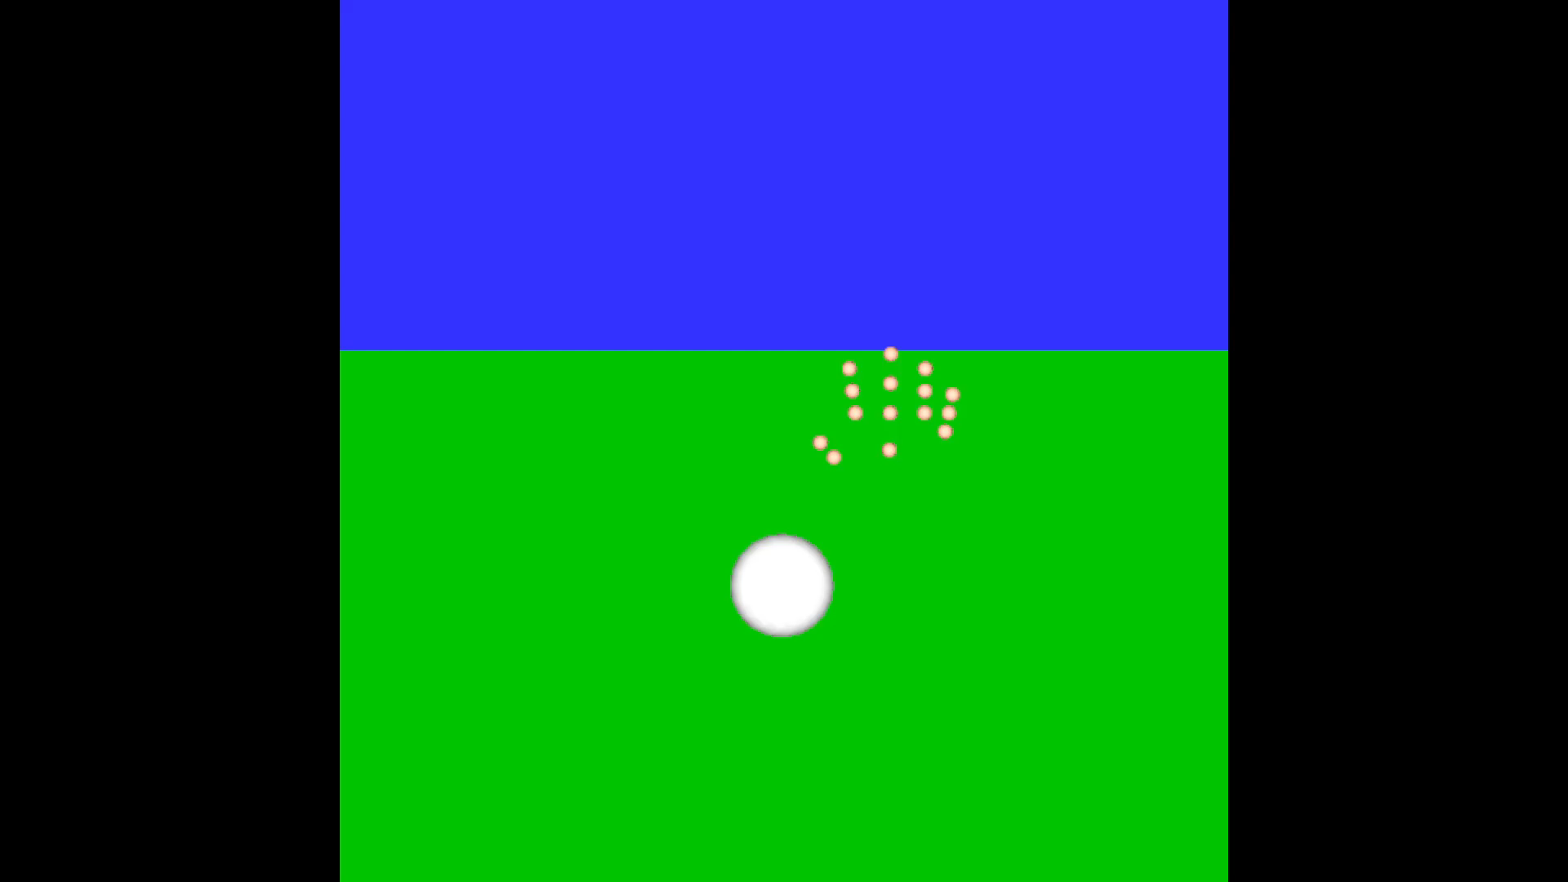
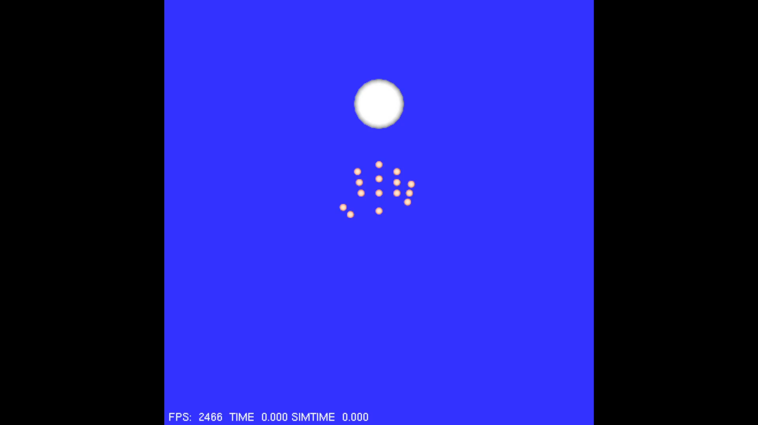
Force Transferring
- Forces can be applied in X, Y and Z
- Forces negate gravity of falling object

Slide 15
Evaluation
Tests based on created parameterization:
- Object Position
- Object Mass
- Object Size
- Forces of Hand
Visual qualitative assessments done on tests

Slide 16
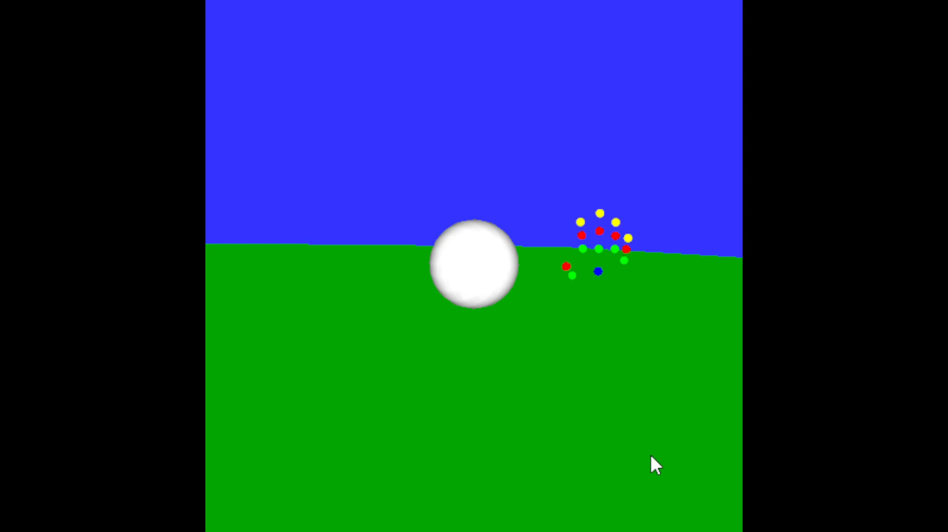
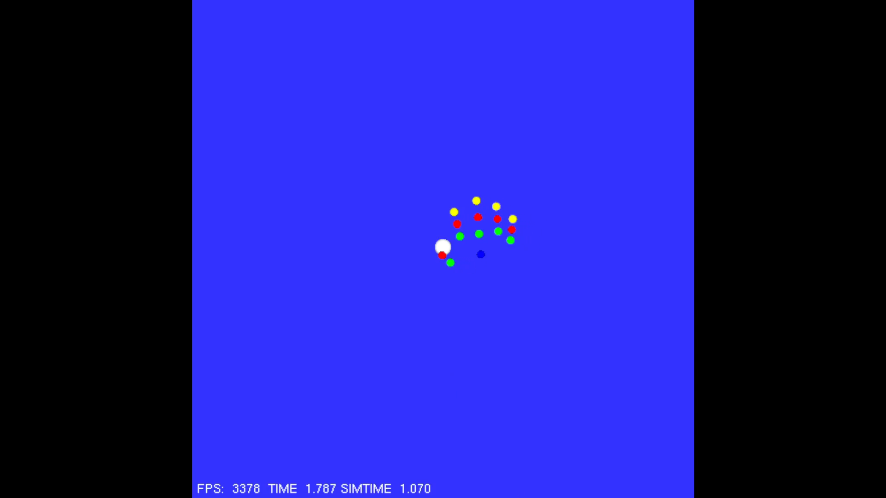
Evaluation of Finger Rotation
- Worked well when object of appropriate size
- Finger rotate speeds are set
- Causes problems when object is too small

Slide 17
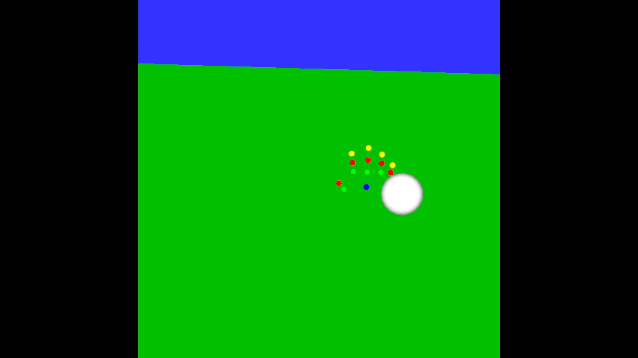
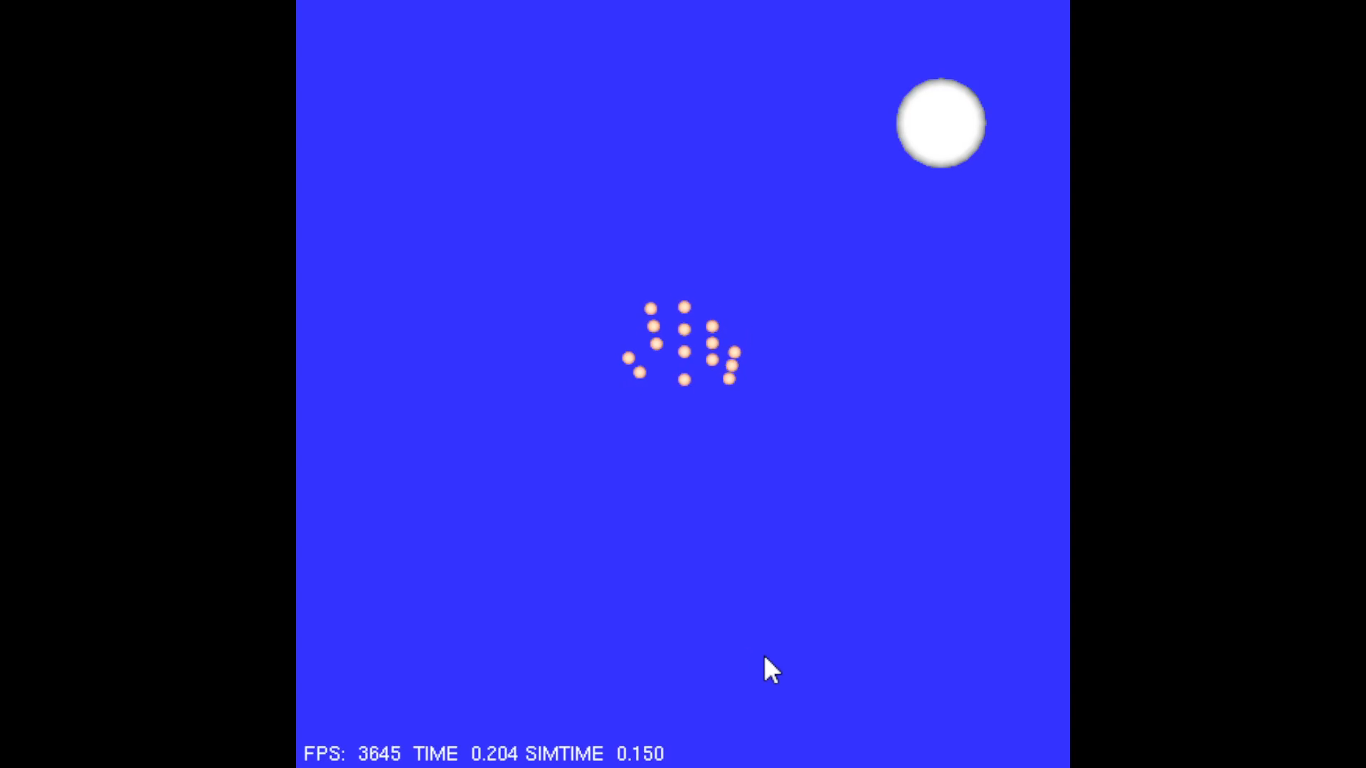
Evaluation of Hand Rotation
- Works in simple cases
- Edge case directly behind hand
- 90 degree problem

Slide 18
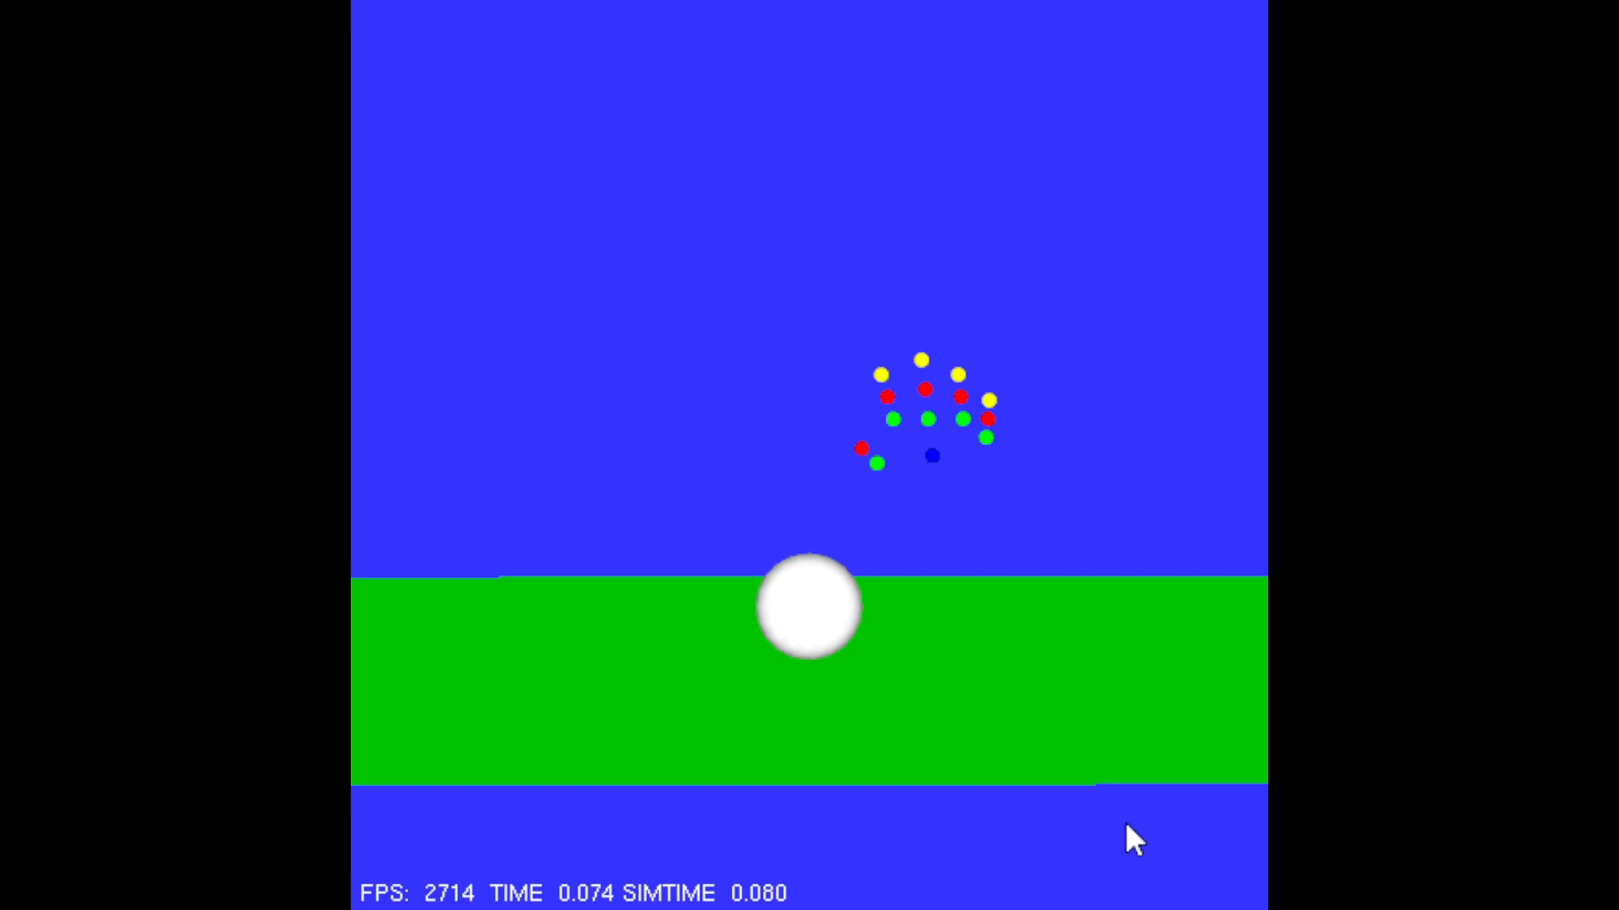
Evaluation of Force Transferring
- Overall, met evaluation
- Problem with ground force

Slide 19
Discussion
- Clear where focus was and were more work is still needed
- Future Work:
Fixes to current system
Dynamics for whole system
Hand model attachment
Motion capture for hand movement

Slide 20
Thank You

